Slide 1


Check in to give us food money

Slide 2
Agents 007: (a brief) iNTRO TO ai eNGINEERING
Caio Carraro Bahlis | Software Tech Lead

Slide 3

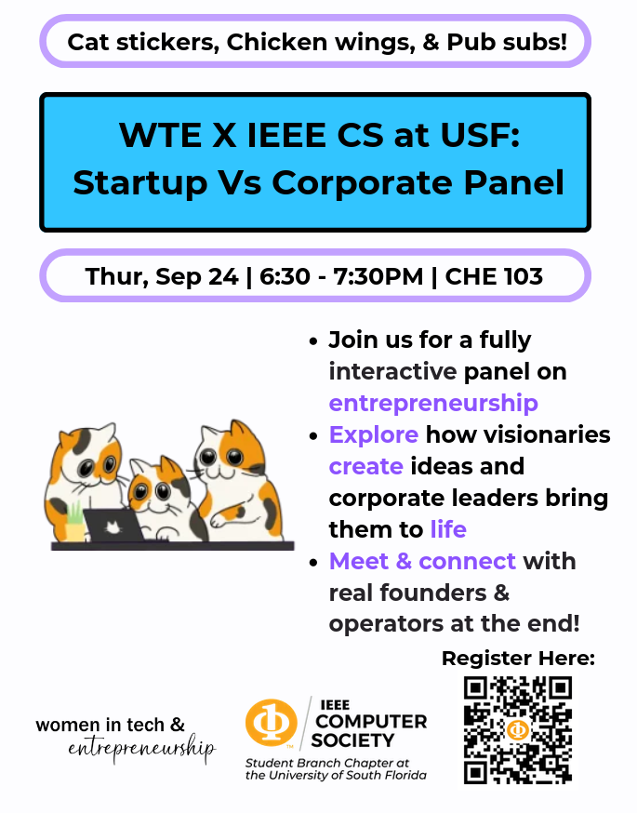

Slide 4
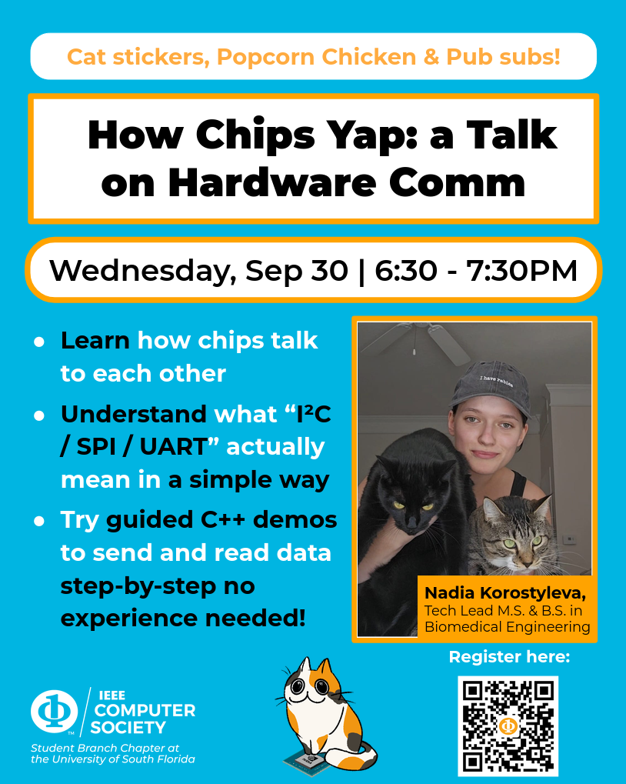


Slide 5


Slide 6

Who Am I???
Facts About Me
Senior
Computer Science & Math Minor
Brazilian & Italian
World's #1 Sudoku Player during August, 2023
Hobbies: Gym, Biking, Lockpicking, Computers, Videogames, Music
I talk a lot
Amazing Grill master
Love & Hate relationship with Gremio
Favorite Bands (now): Stone Temple Pilots, The Black Keys, Linkin Park, Racionais MC
Me!!!​
Not Me

Slide 7

WORKSHOP Agenda
What is an AI Agent
What is a LLM
Agent Building Blocks
LangChain & LangGraph (concept)
Food Break
Framework Fundamentals
Our Amazing Demo
QA

Slide 8
What's an AI agent anyway
Agents are used in multiple different contexts. For this workshop, an agent is a LLM based system that is capable of observing an environment, thinking, making a decision and repeating the process.
Market State
At first, it seems that Agents are just overglorified ChatGPT wrappers (not totally wrong), but they are extremely powerful tools, capable of automating even the most complex of tasks.
AI Agent
Buy
Sell

Slide 9
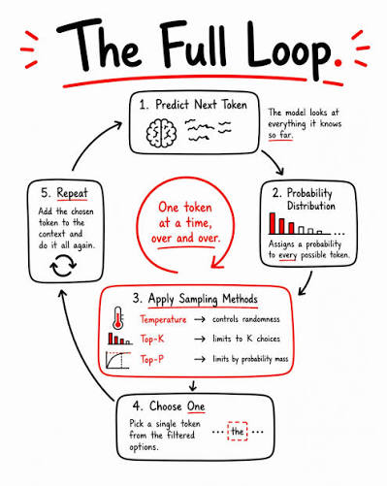
Explain llms like I'm 5 years old.
"An LLM is a machine that predicts the next word in a sentence."
Curiosity killed the _? (Cat 100%)
It was a dark and stormy ___? (Night 50%, Day 20%)
All roads lead to _ ? (Rome 50%, Renato Portaluppi 10%)
LLMs are what power ChatGPT, Claude and many other AI Models.
GPT-6, for example, was trained on 13 trillion tokens. After reading that much, you start understanding seemingly invisible patterns in language. About the number of words 32.500 people say in their lifetime.

Slide 10
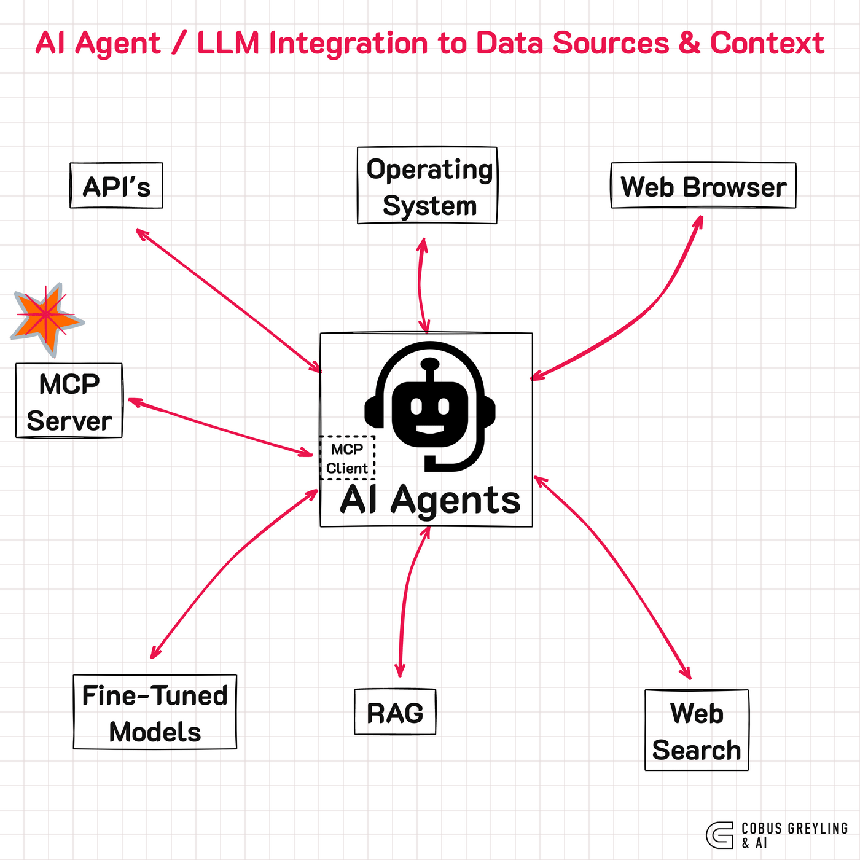
Agent buILDING BLOCKS
Agents by themselves are not that powerful, but we can connect them to different services to make them much powerful
All the integrations, functions and overall behavior of an agent are defined by the system prompt.
Tools: Functions coded by the user that the LLM can call to perform a function.
Memory: Obsidian, Milvus, Pinecone
IDE/Coding Tools: Claude Code, Codex, Cursor
Planning/Reasoning: ReAct, Chain-of-thought prompting

Slide 11
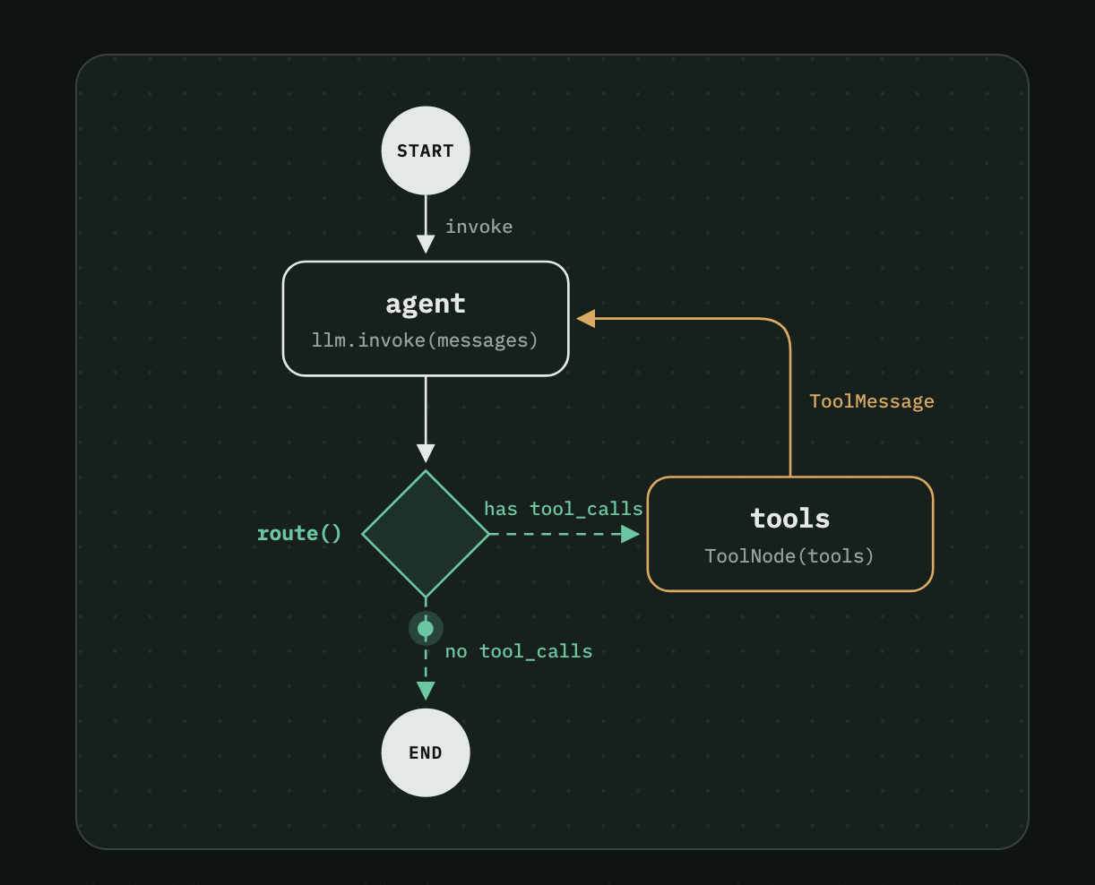
Langchain & langgraph
LangChain and LangGraph are python frameworks that let you build agents, tools, MCP servers and much more.
LangChain lets you "chain" together steps, using the output of one step as the input to the next (also called chaining).
LangGraph is geared towards the architecture of a task. Breaking it down into steps, and giving you explicit control over the execution flow between them.

Slide 12



Enjoy our food & COMPLIMENT MY CAT!
Name: Lumi
Weight: 15 lbs
Age: 10
Nicknames: The Cat, Tiger, The Beast, Fluff Triangle, Gray Alarm Clock, Purring Machine

Slide 13
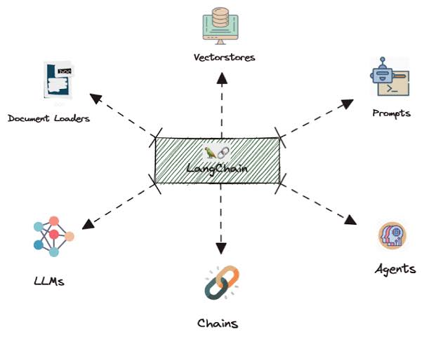
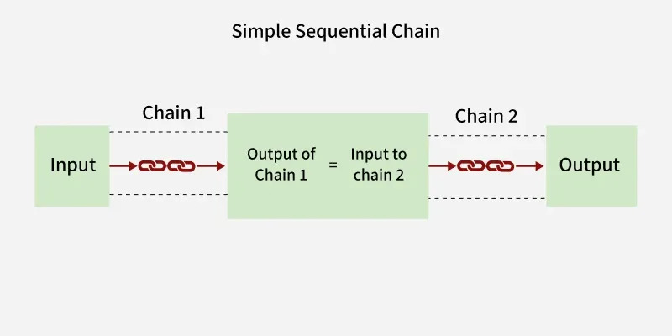
Explain langchain like I'm 5
Core Concepts: Models/Wrappers, Tool, Chaining
Langchain provides native wrappers to different LLMs, letting us just call them with a simple invoke() call.
Langchain also has built-in classes to support Tool Calling, letting the LLM call code functions and use them in their response.

Slide 14
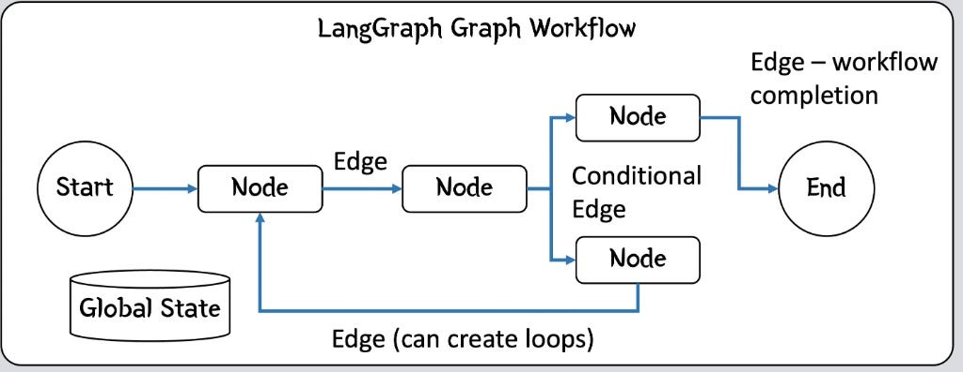
Explain langGraph like I'm 6
Core Concepts: State, Nodes, Edge & Conditional Edges, Graph
Langgraph draws a execution path for your agents, and Langchain simply runs it.
Now, Instead of simply chaining agents blindly, we can decide when to chain them, and control the execution according to variables.

Slide 15
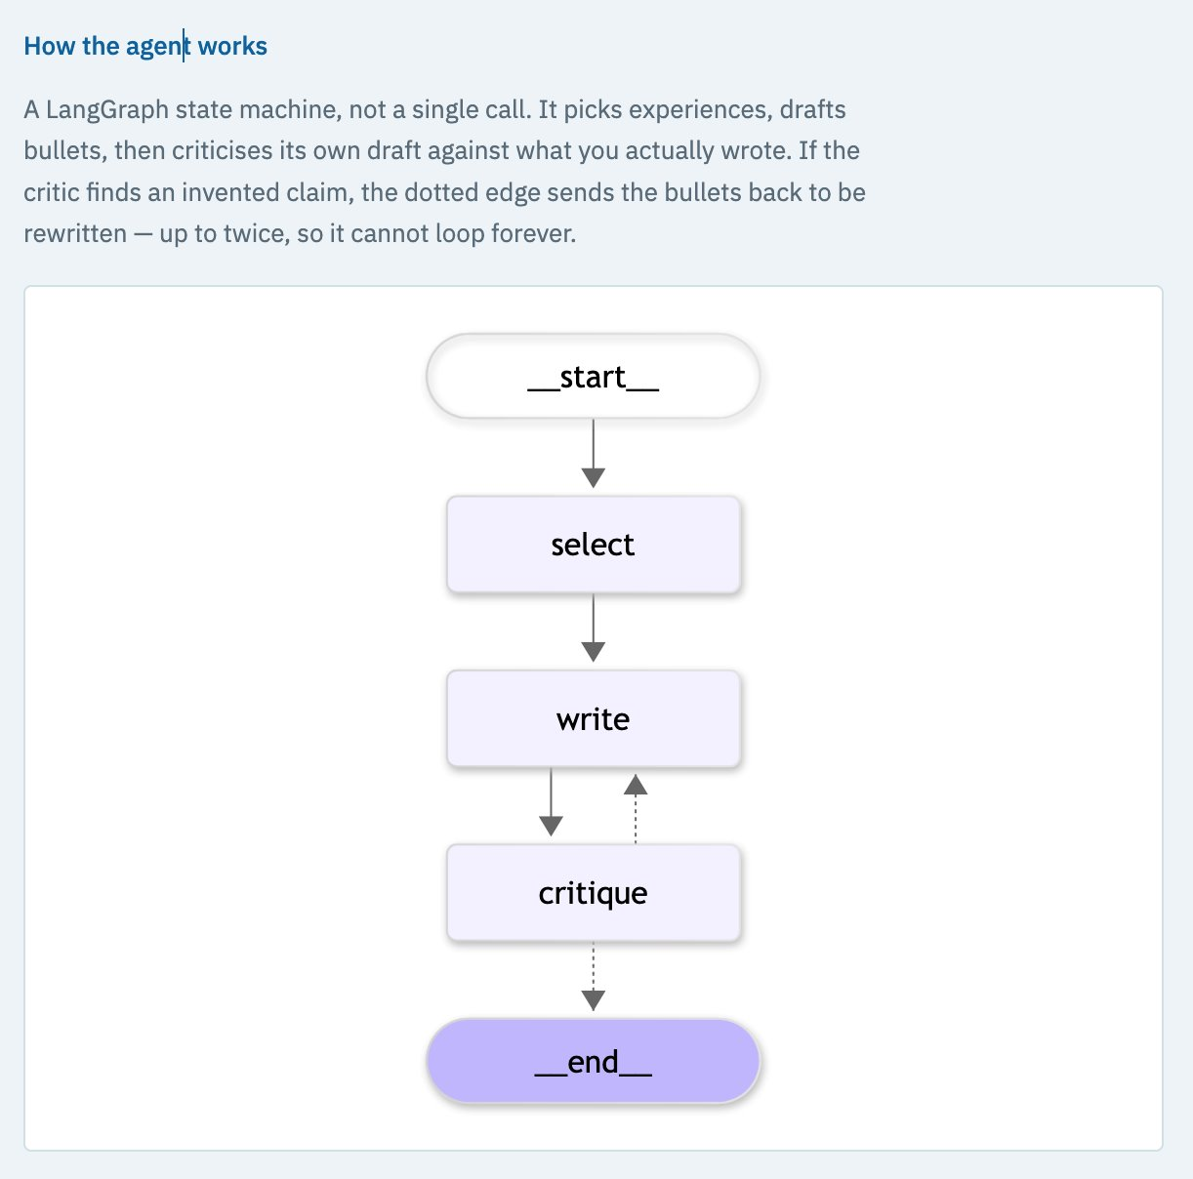
Multi Agent System Demo
Our Demo consists of a Resume adapter. You're can paste all your bullet points, and given a job description, the agents format the bullet points that match that description the best.
In total, we're going to use 3 Agents.
Node 1: Receives Job Description and tailors bullet points taken from our experience.
Node 2: Writes a resume based on the tailored bullet points
Node 3: Reviews the resume for accuracy and effectiveness, and re-writes it if needed
Caio Carraro Bahlis

Slide 16




Learning resources
LLMs from scratch
AI Engineering
Langgraph & Chain
Demo (GitHub)

